Slide 1
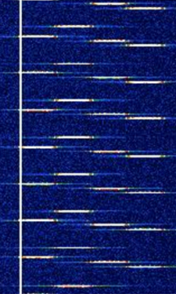
Electronic Warfare(EW)-101
A very non-structured introduction to EW in drone space

Slide 2
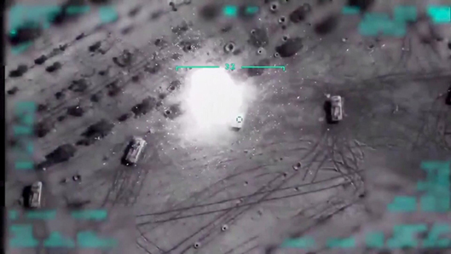
Not the What, but the Why? Why EW in aerial arena?
Let's take a look at 2 recent conflicts in high level detail.
Operation Spring Shield: Turkeys counter joint ground, artillery and air operation on Syrian forces.
Pic Courtesy: https://smallwarsjournal.com/

Slide 3
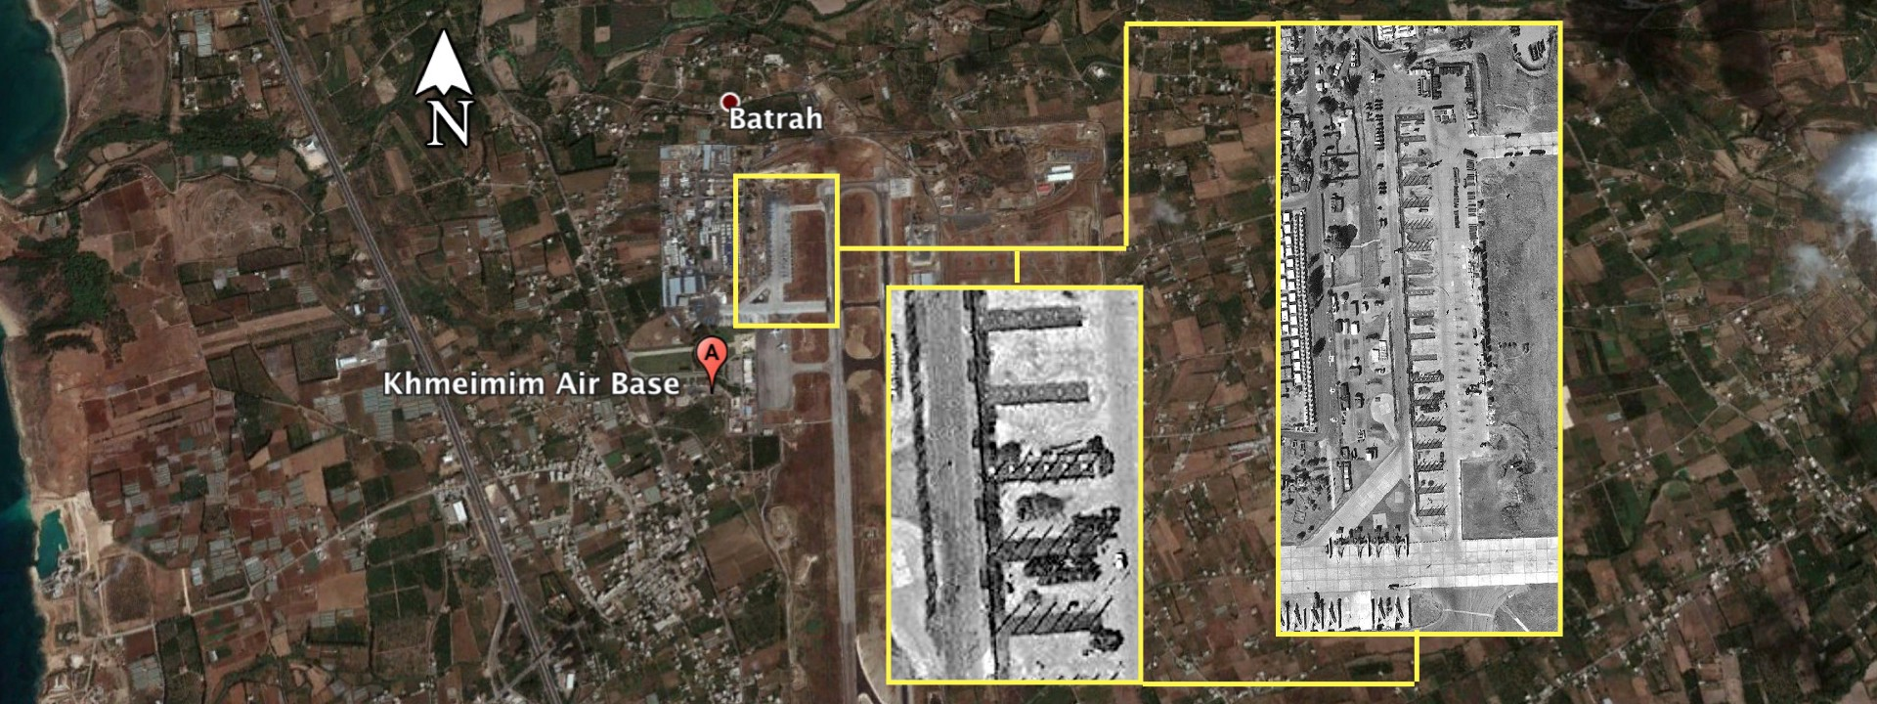
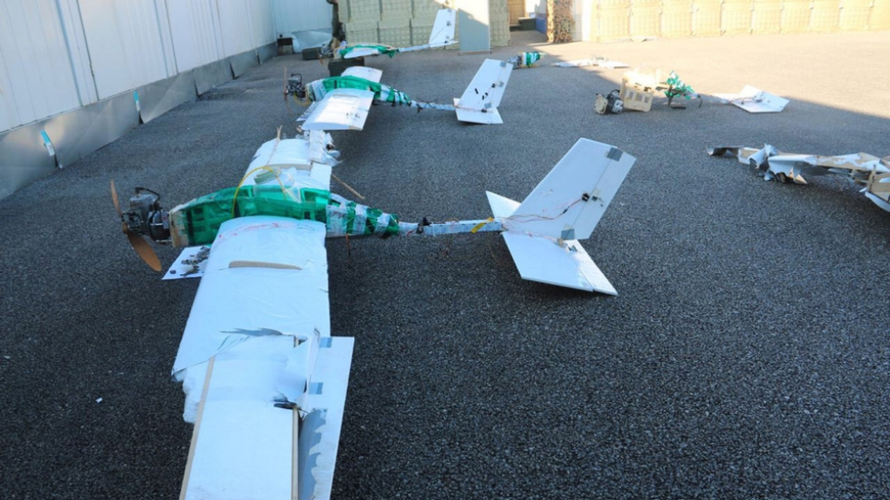
What Happened?
Overview : Assad’s forces were backed by the Russian’s, and the key strong presence of Russians in Syria was two places Khmeimim (Air Base) and Tartus (Naval Base).
The Air base
Drones Used in Attack

Slide 4
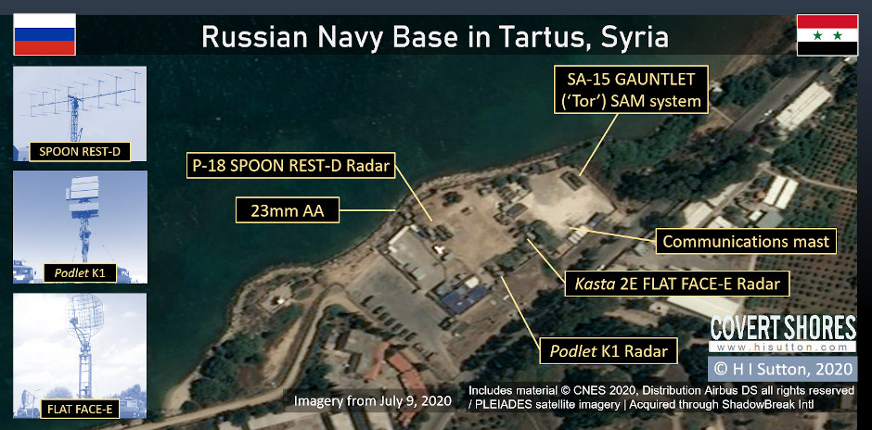
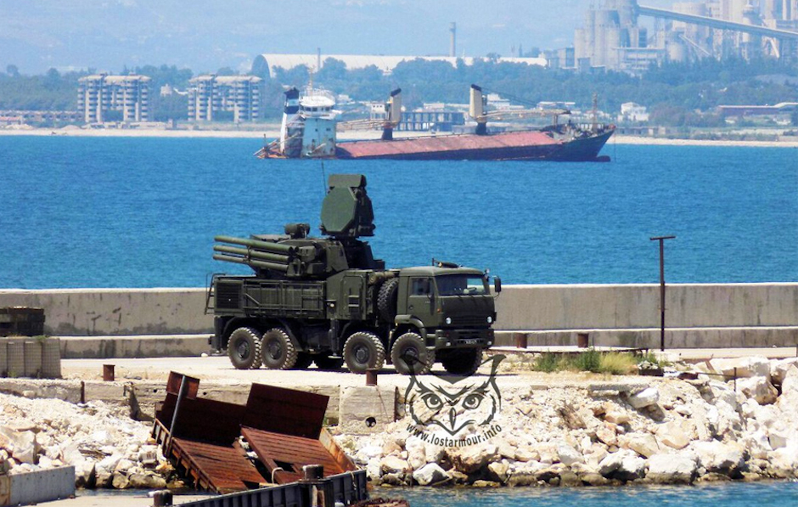
Tartus naval Base
Image Courtesy: H1Sutton

Slide 5
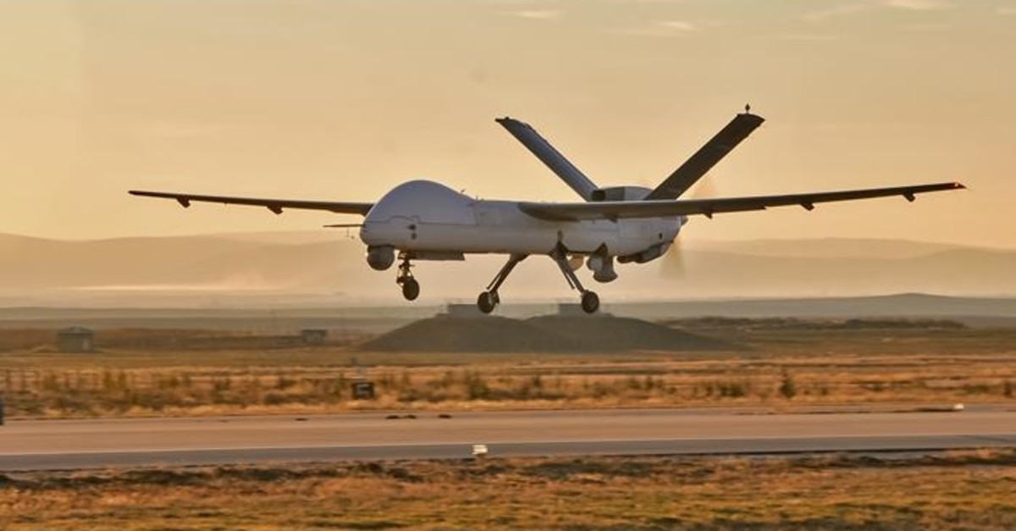
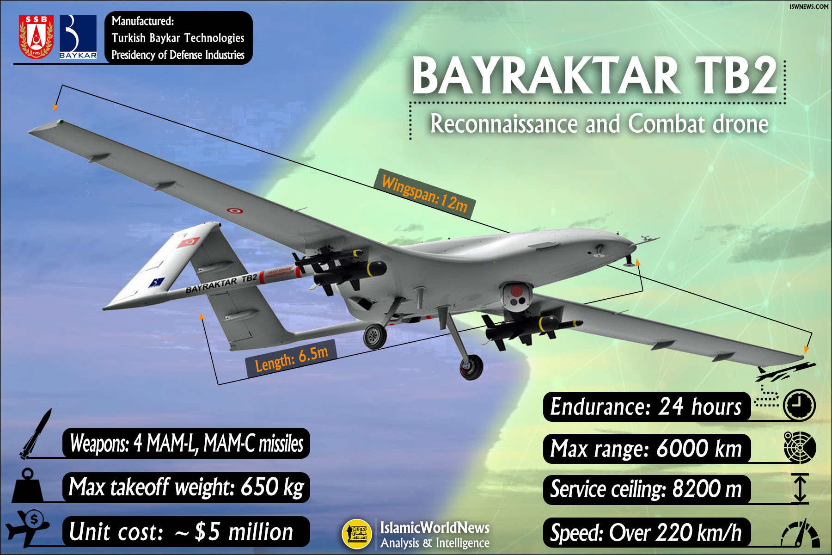
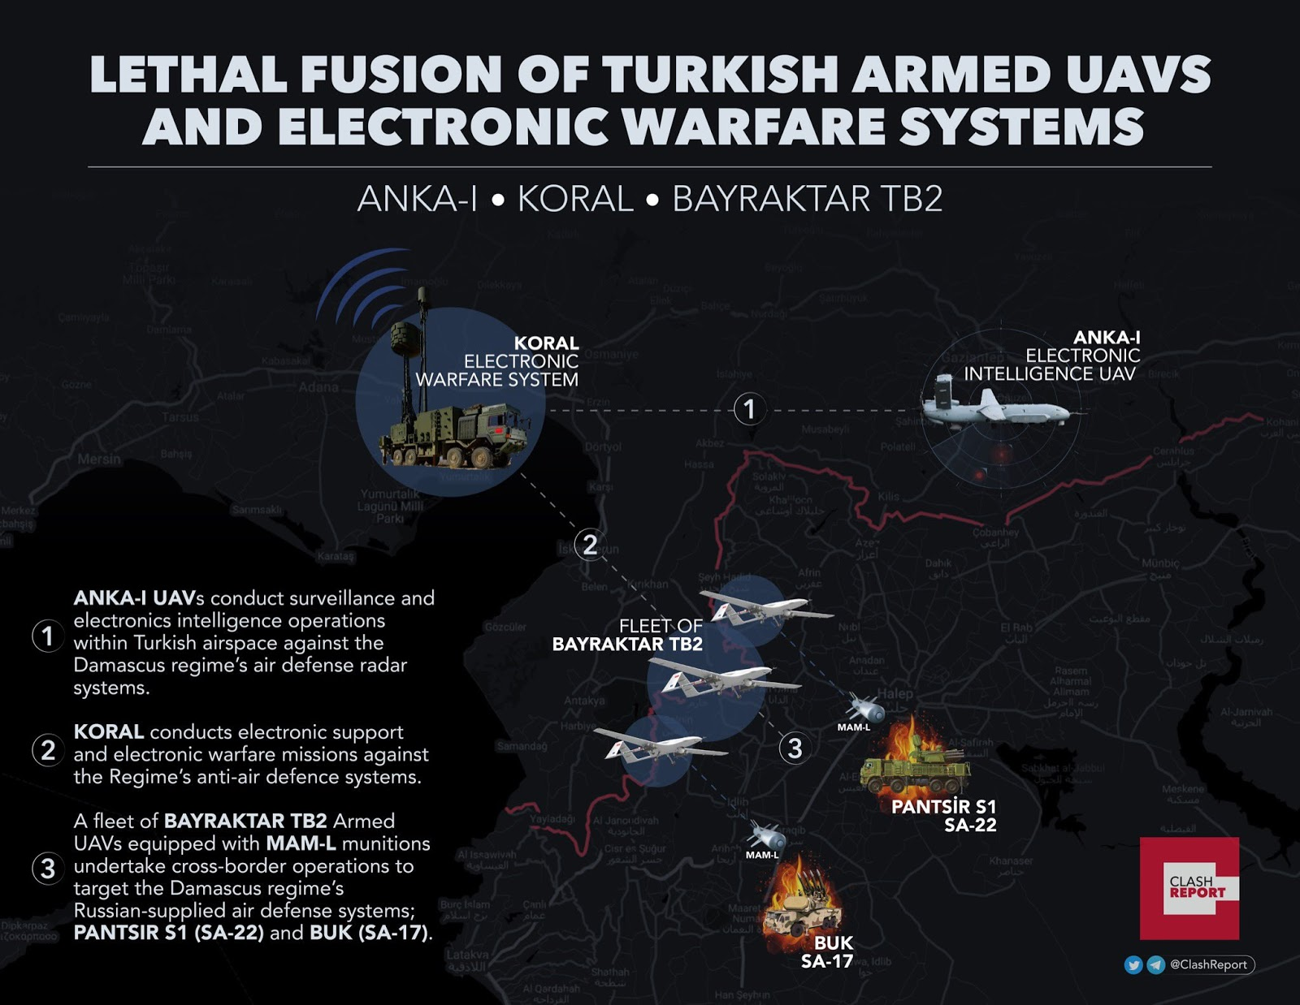
So in brief
Anka
Turkish Air Industries (TAI) has two drones: TAI-Anka and TAI-Bayraktar
Anka is equipped with Koral-EWS system
Bayraktar

Slide 6
How the attack happened?
Step 1: SIGINT showed SoP in the the Air base where jammers were turned off to make the instruments of the plane that is taking off to acquire signals.
Step 2: Drones Infiltrated this Denied Airspace when the jammers were turned off.
Step 3: TAI-Anka relayed signals information to Koral.
Step 4: Targeting information was then relayed to Bayraktar via dedicated datalink (Under Jammed Conditions).
Step 5: Bayraktar dropped all its munitions and conducted kamikaze strikes on the remaining Pantsir systems bringing the entire infrastructure down.

Slide 7
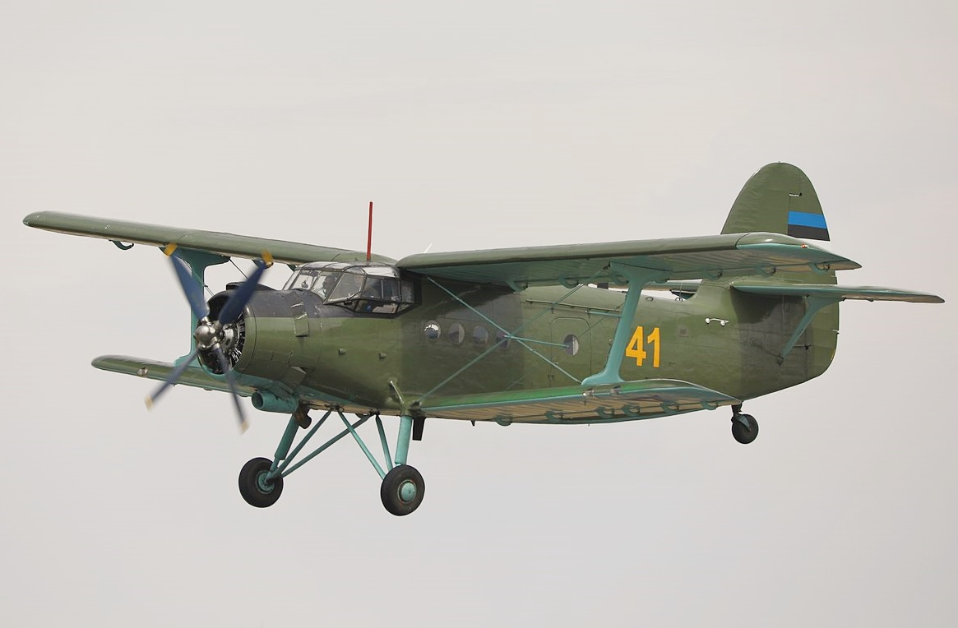
2. Nagorno-Karabakh conflict
Star of the show: Bayraktar
Co-Starring :An2
What happened:
An2 was equipped with ESM equipments and flown into Armenian airspace.
Armenians thought this was an high altitude ground splitters and turned on their SAM system.
GAME-OVER, total devastation of all the artillery and SAM systems.

Slide 8
The Takeaway:
After the jungles of Vietnam and the deserts of Afghanistan, drones are the new form of “Asymmetric Warfare”
Cheap disposable drones are the necessary technology for this come through.
On board ELINT and COMINT are the game changers.
On board EA (Jamming and deception) are also a part of this suite.
IMPORTANT: Counter Drone Technology.(Higher directional Jammers, mmWave detection systems, Directional Energy Weapons (DEW))
Notes:
Give importance to why this might be a advantage for us in our present space

Slide 9
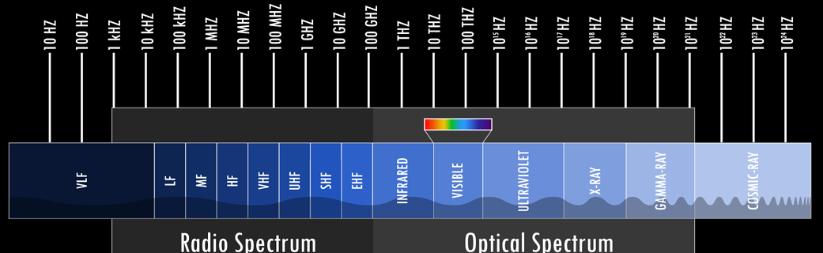
Question: What enabled all this technology?
A: The principles of Electronic Warfare:
But what is Electronic Warfare?
Wikipedia Definition: Electronic warfare (EW) is any action involving the use of the electromagnetic spectrum (EM spectrum) or directed energy to control the spectrum, attack an enemy, or impede enemy assaults.
My definition: Establishment of EMS superiority so as to protect, and attack necessary. This includes the entire EMS (RF, microwave, mmWave, IR, UV, THz and Optical.)

Slide 10
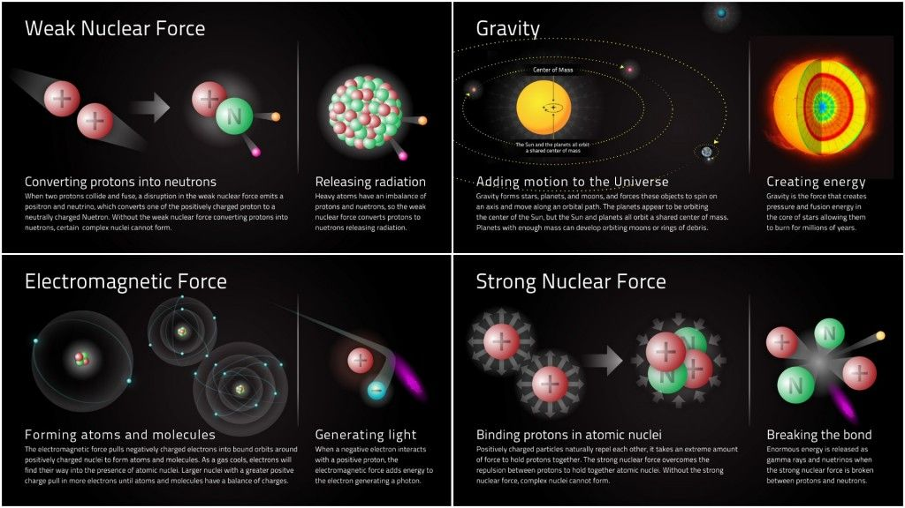
But why playing with electromagnetic spectrum
Only fundamental force of the universe where we can play around without causing a global catastrophe where all of us threatened.

Slide 11
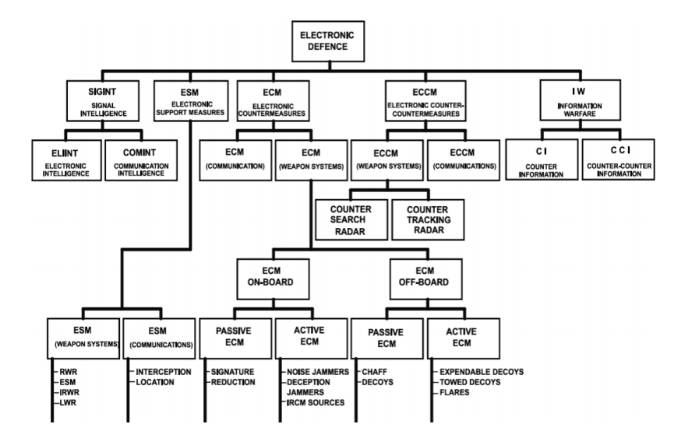
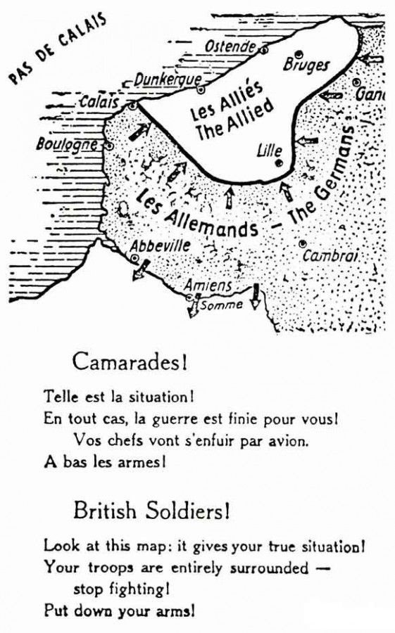
Electronic Defense Concept: The 10,000 ft view
Broad Classification:
SIGINT
ESM
ECM
ECCM
IW(Broad Scope: Look here)

Slide 12
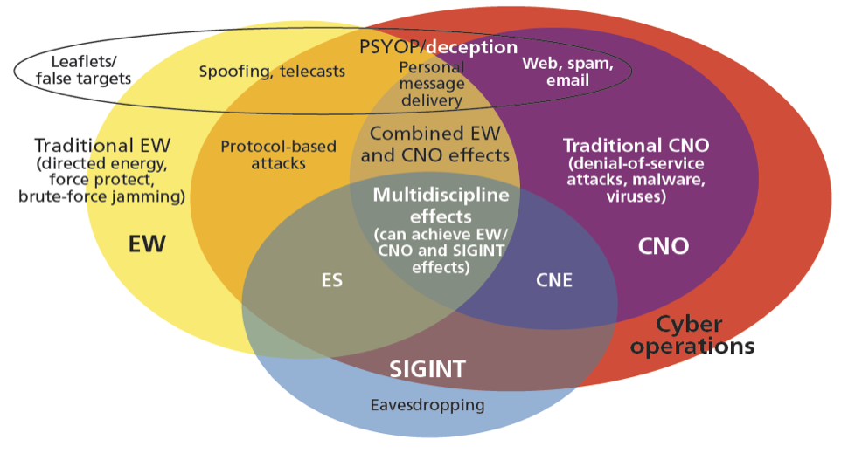
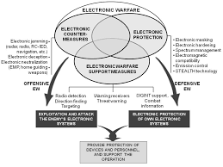
SIGINT: ELINT and COMINT
SIGnals INTelligence(SIGINT)
First entry point in understanding the surrounding EMS. Classified further into two further parts
ELectronics INTelligence (ELINT)
COMmunications INTelligence (COMINT)
Notes:
Talk about different types of ELINT including TechELINT, FISINT, understanding the EOB and SoP of enemies.

Slide 13
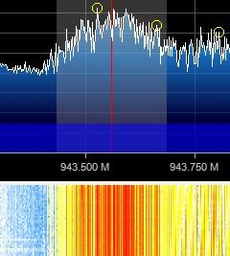
COMmunications INTelligence (COMINT)
Understanding Data Communication Signals in an enemy space, this include dedicated datalink and telecommunication signals.
Datalink signals can be from networked RADAR’s for AD/AWS, SATPHONE emissions originating from the area.
This include Amateur Radio broadcast, understanding of telecom network operators in the area which might be a precedent to tracking down specific internet gateways into our country.

Slide 14
Technical Warning: The next few slides might be too much theory into understanding.

Slide 15
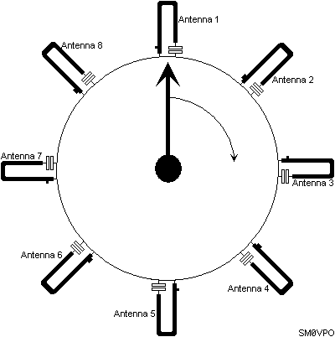
Electronic Support Measures (ESM)
2 sub-types of classification:
ESM-Weapons RADAR Warning Receiver (RWR)
IR lock warning systems
ESM-Comms
Interception
Locating (Direction Finding)
Image Courtesy: European Amateur Radio Community

Slide 16
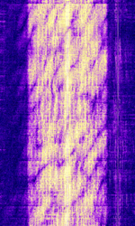
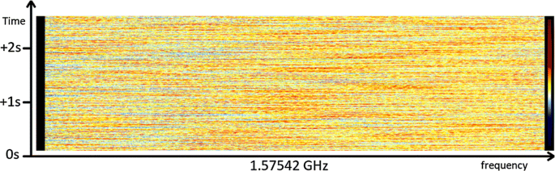
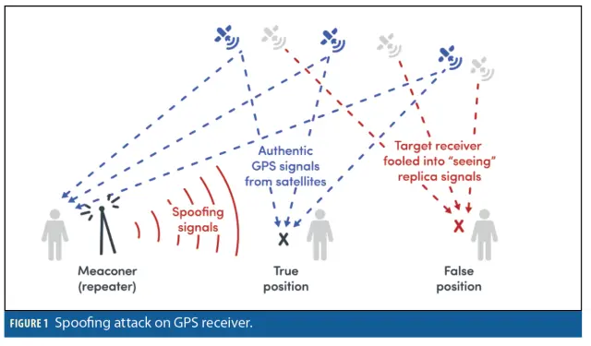
Electronic Counter Measures (ECM)
Chinese Firedrake jammer, in Radio Free Asia(HF).
Once we have enough information about EMS, it is time take action based upon data provided from recon phase (SIGINT).
2 types:
ECM-Weapons:
Optical Dazzlers
Chaff’s
Digital RF Memory (DRFM)
Signal and noise modulated jammers
ECM-Comms
Jammers and Signal Spoofers

Slide 17
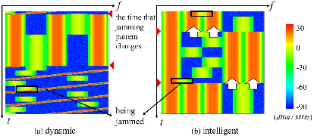
Electronic Counter Counter Measures (ECCM)
Protection of our own sensors and systems while we are under attack.
Essential as the adversary also does the same things that we specified that we mentioned before.
Necessary:
Jam and Spoof resilient data-links
Private standalone systems
Ad-hoc systems
Intelligent spectrum monitors and signal identifiers

Slide 18

But on drones, how?
All these needs to be done on a drone, this means that we need a enabling technology.
A: Software Defined Radios (SDR) and re-programmable RF Front End equipments.
SIGINT for a end user in the present day is matter of buying the cheapest SDR and using it get spectrum data.
The most important: Utilization of open source technology to our advantage.

Slide 19





Integrating SDR on drones
Drone + SBC (Single Board Computer) + Entry Level SDR (I’d say start with a rtl-sdr or some similar DVB-T tunable dongle)
SBC can be a raspberry pi or any board with a good computation facility (like odroid, tinker, Udoo).
Linuxize the SBC and leverage open source software like GNU Radio Companion (GRC), python and drivers from the vendors, transfer the data to ground and analyze the data or perform operation on air itself (trade off)

Slide 20
Resources and References
https://smallwarsjournal.com/jrnl/art/turkeys-drone-war-syria-red-team-view
http://www.hisutton.com/
https://www.sigidwiki.com/wiki/Signal_Identification_Guide
https://www.rtl-sdr.com/
https://earth.google.com/
https://maps.google.com/
https://www.youtube.com/channel/UCceoapZVEDCQ4s8y16M7Fng
https://www.youtube.com/user/pspheaven
https://www.youtube.com/channel/UCJmlLMsfdZ6BsPmb7ocebTg

